Slide 1
Pause

Slide 2
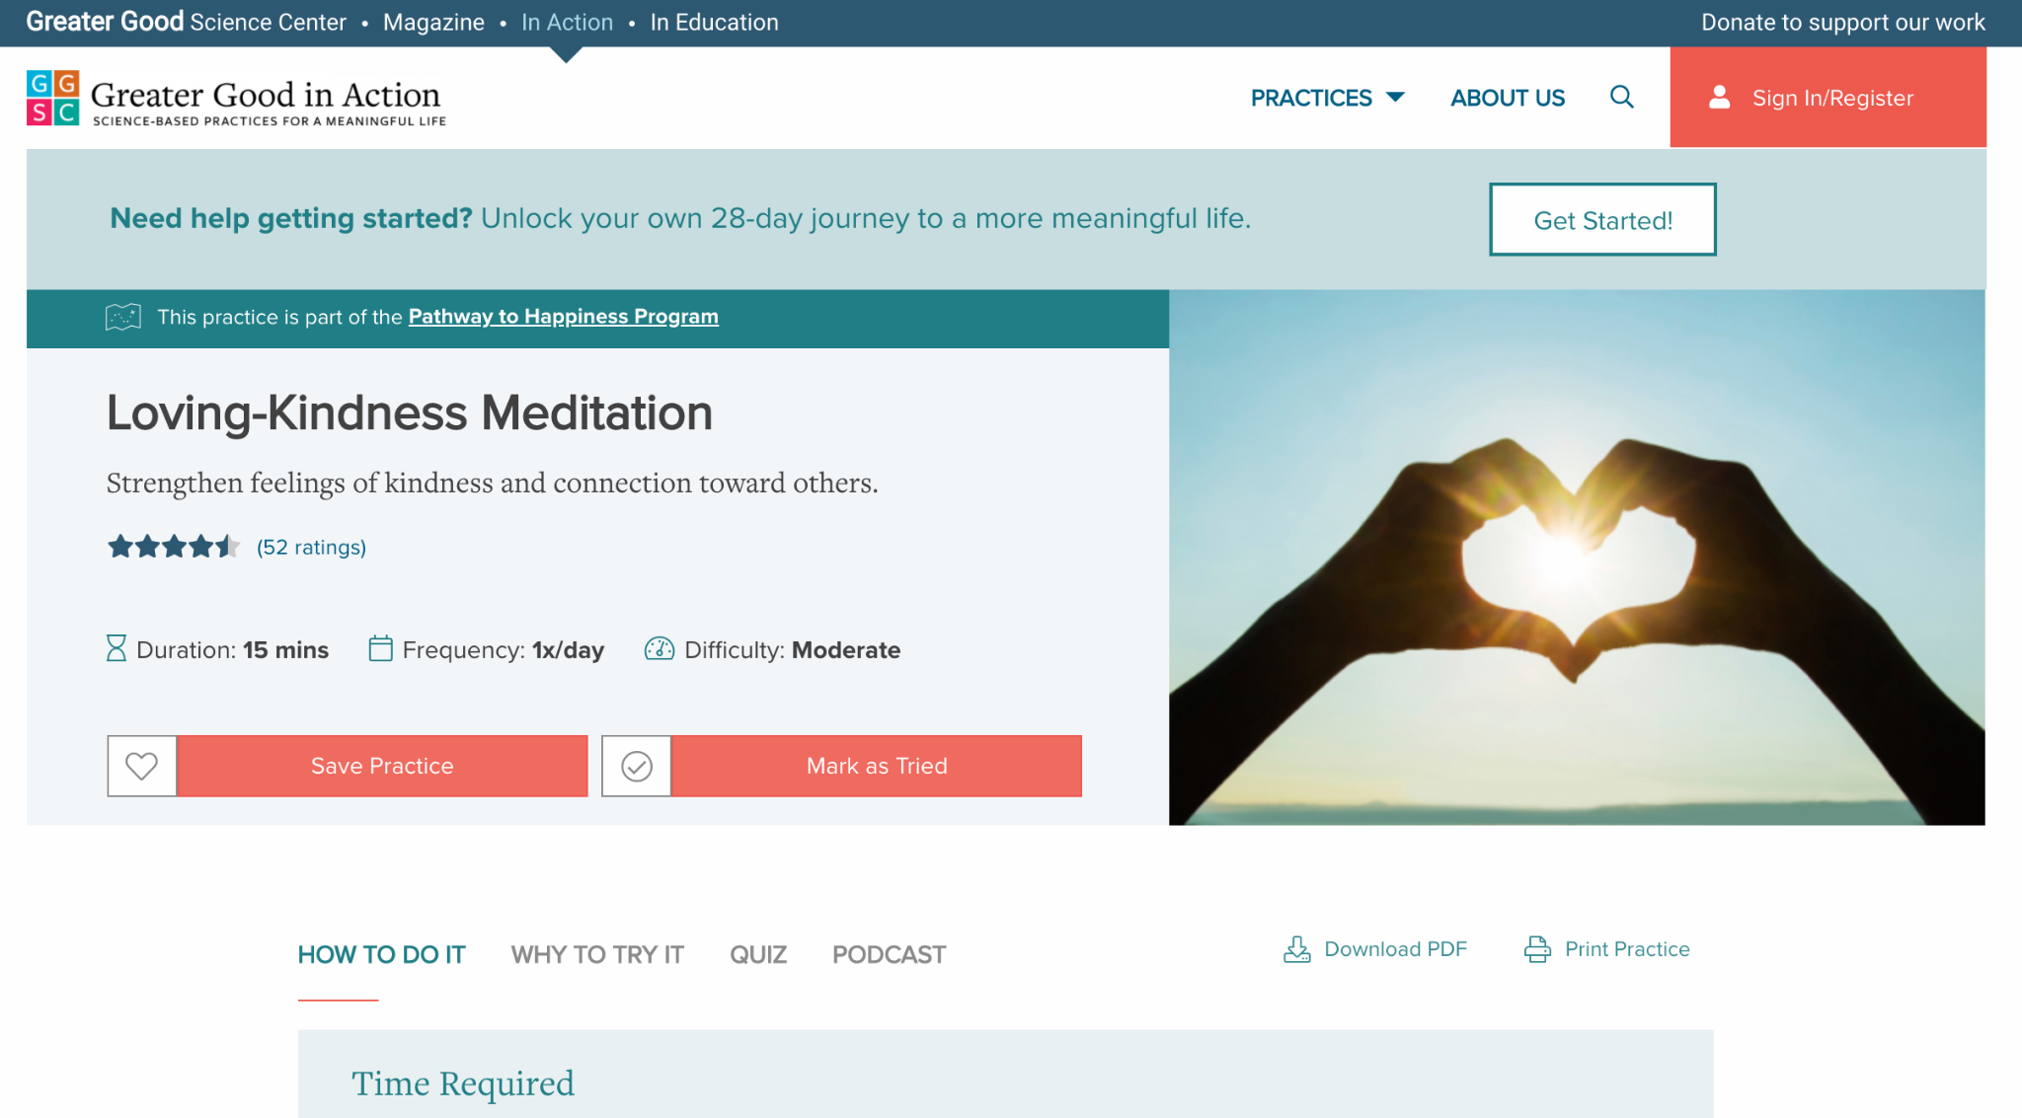
Notes:
PEOPLE AS POETRY
https://ggia.berkeley.edu/practice/loving_kindness_meditation

Slide 3
[Role models]

Slide 4
Be curious
What behaviours, mindsets or moments inspire you as you’re observing people in your life?
Why do they get your attention?
What about them would you like to strengthen in yourself?

Slide 5
Super You
Get feedback on what your assets are?
Which ones are most important? Unique? Memorable?
Which assets are most valuable?
Which are most supportive of your values?

Slide 6
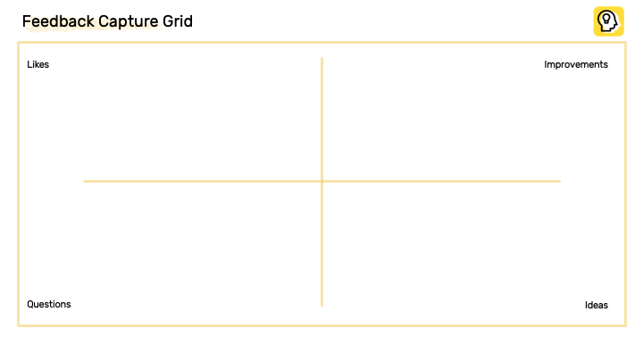

Slide 7
[My top values]

Slide 8
[prioritisation matrix - value & importance]

